Slide 1







Dr. Matt Wood
matthew@amazon.com

Slide 3



Slide 4




Slide 5




Slide 6
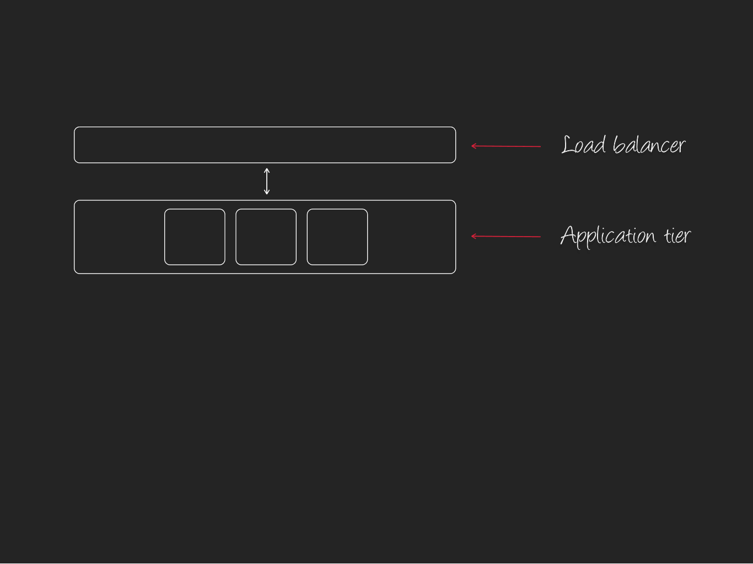

Slide 7
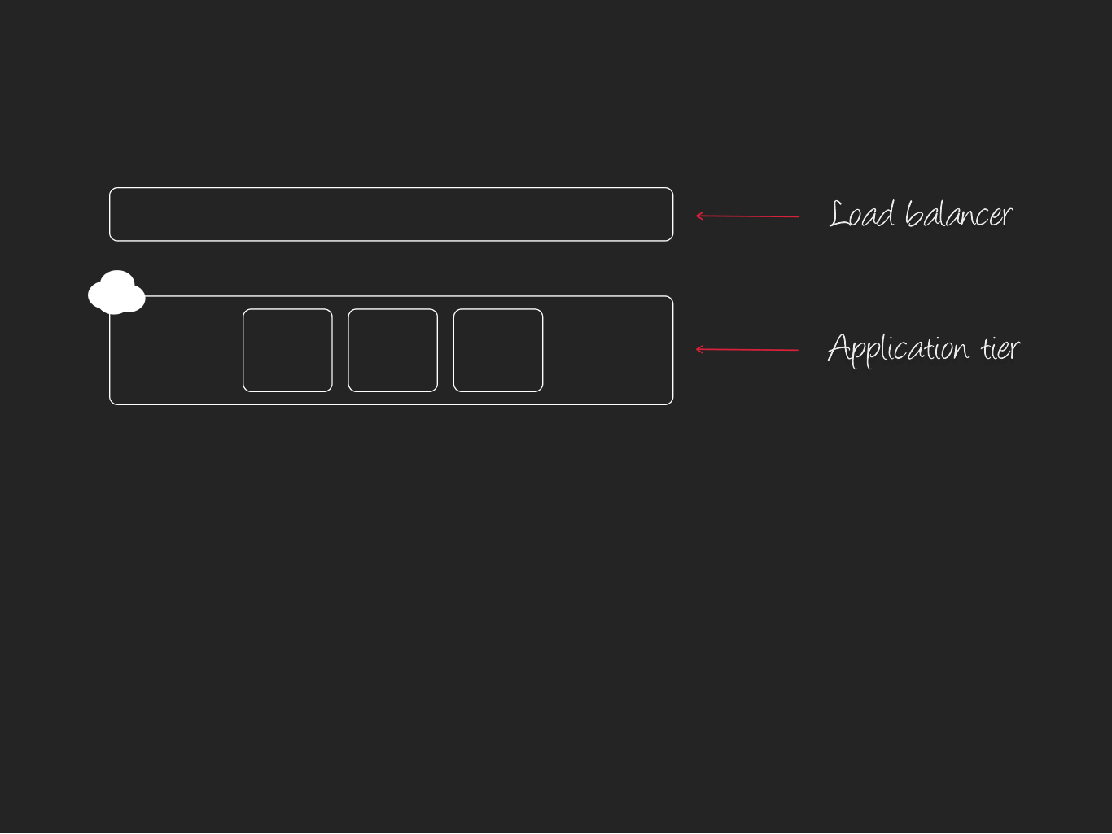
4

Slide 8
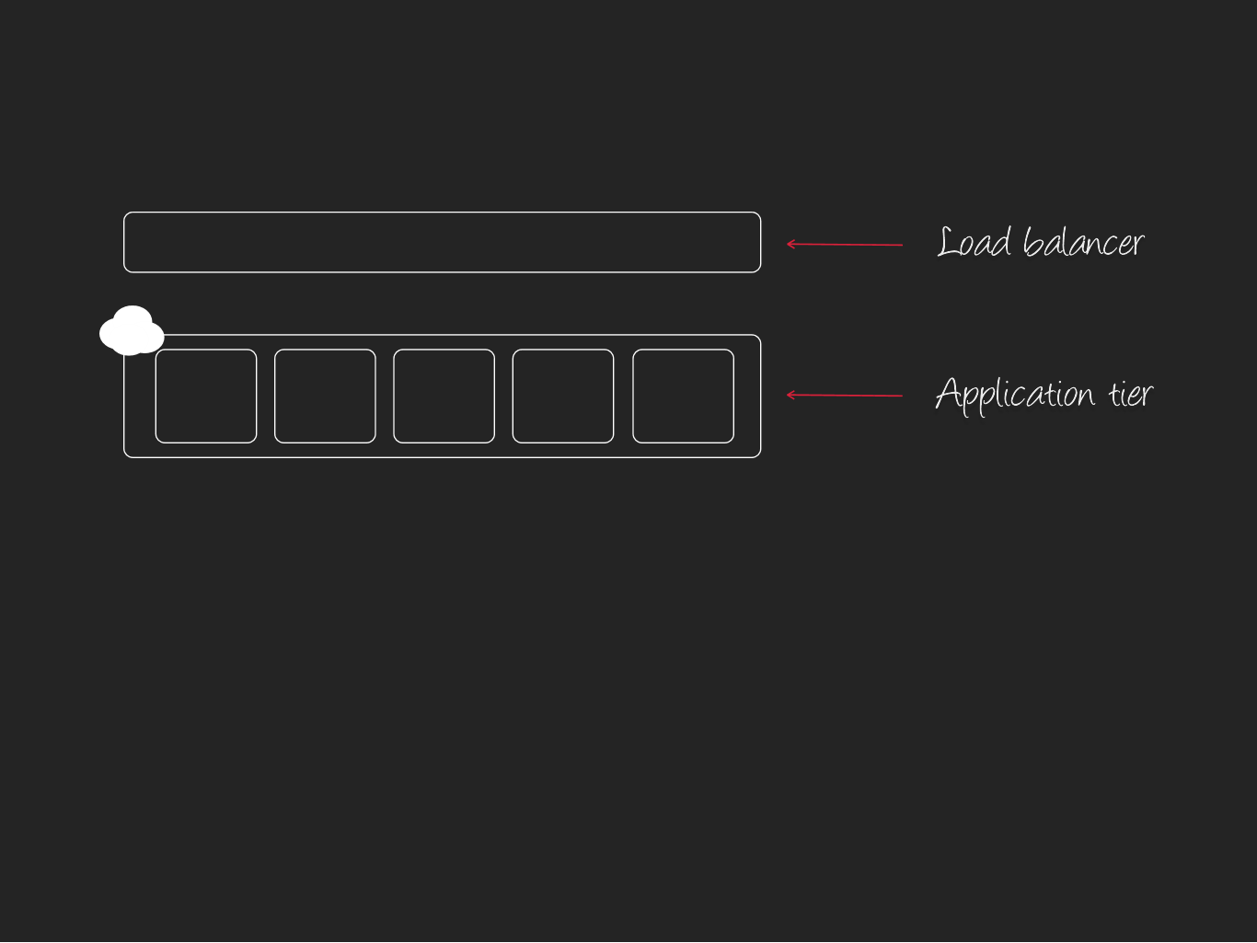
4

Slide 9
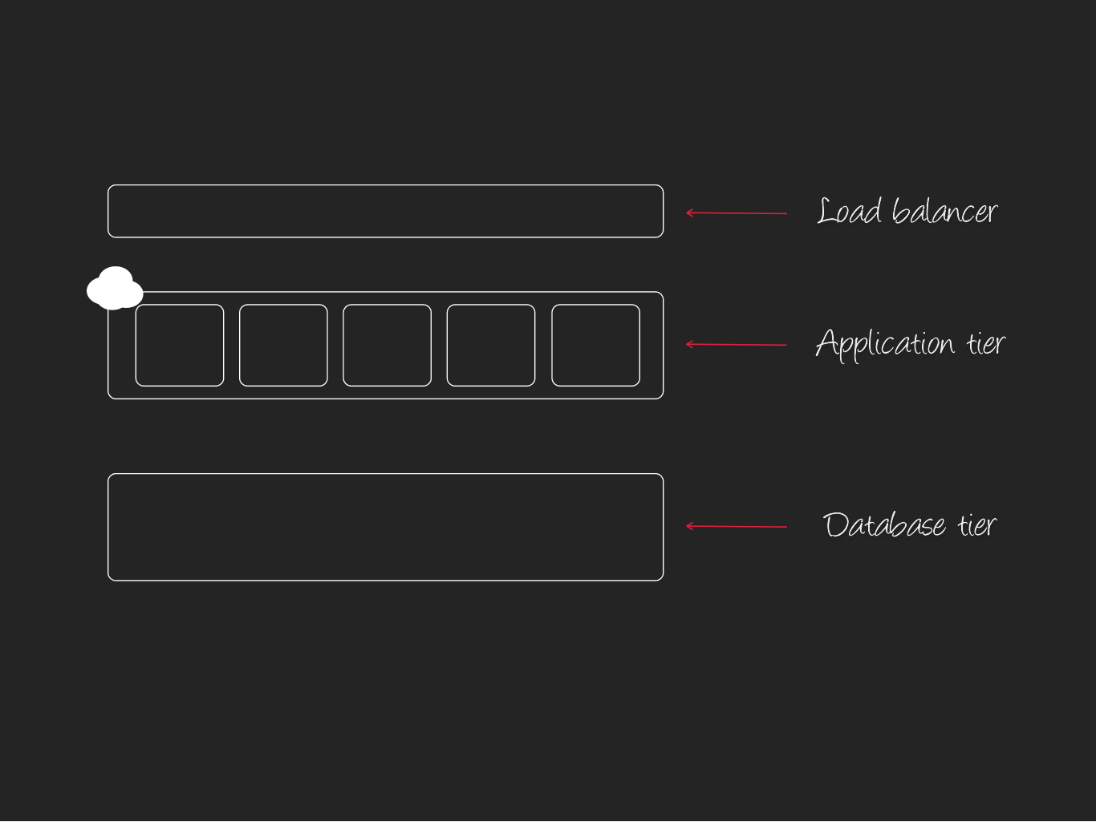
4

Slide 10
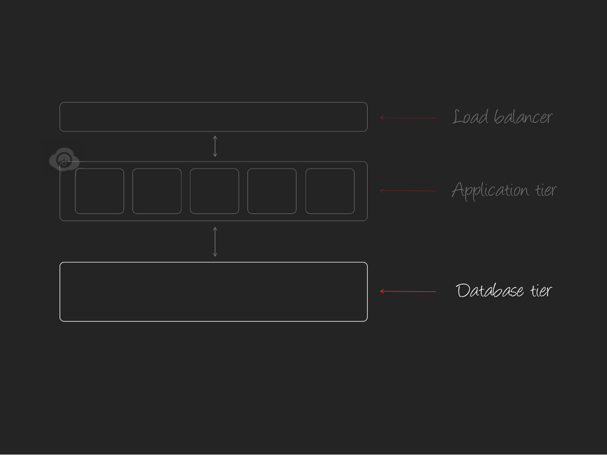

Slide 11
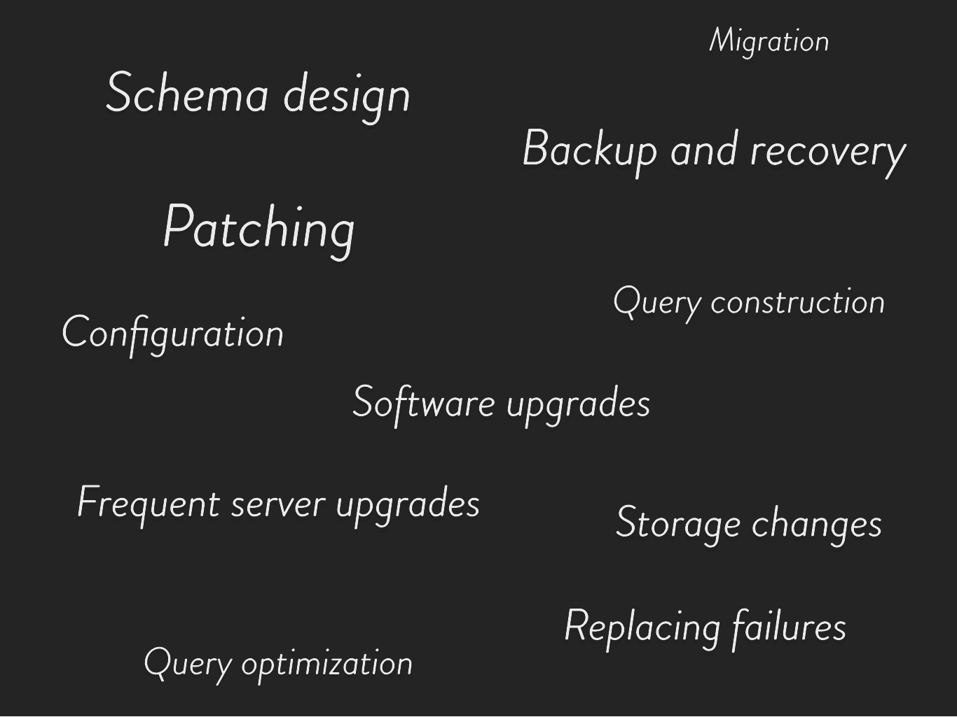

Slide 12
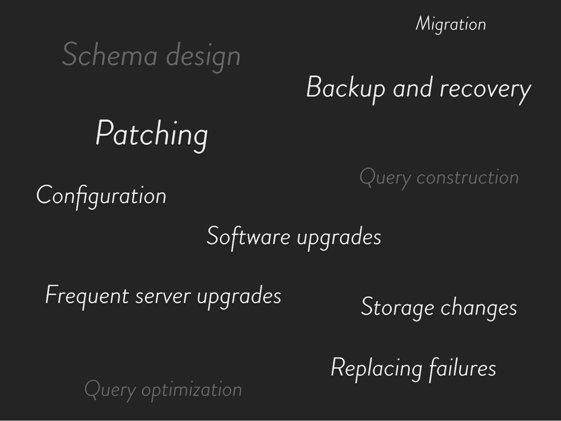

Slide 13
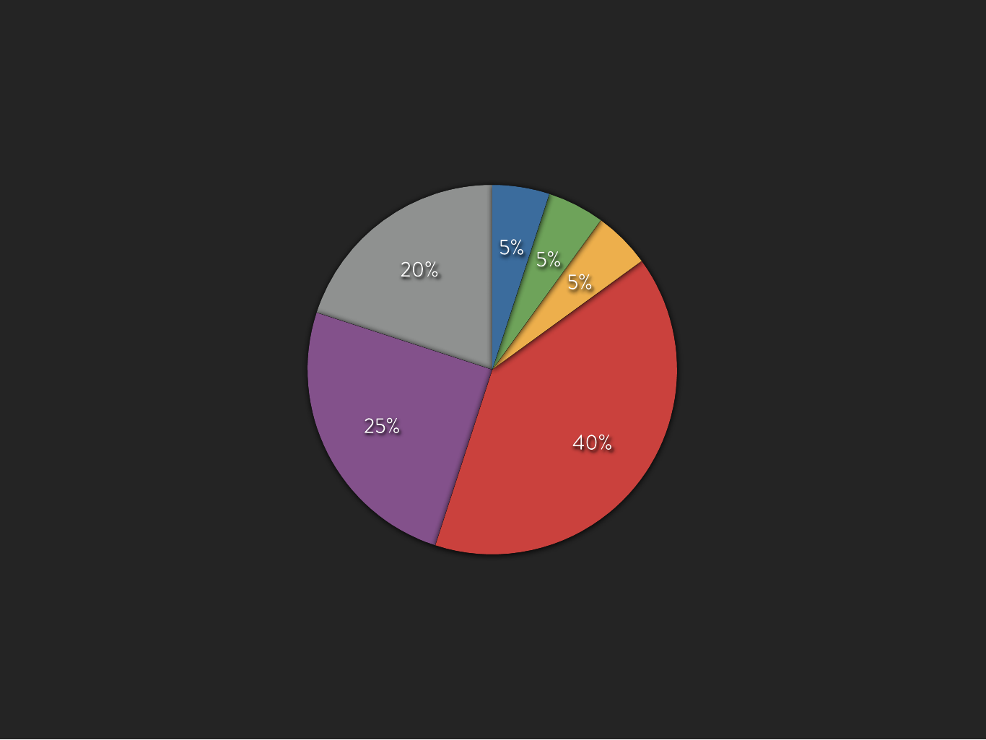

Security planning
License training
Backup, recovery
load and unload
Script automation
Performance
and tuning
Installation, upgrade,
patching, migration

Slide 14


G

Slide 15



Slide 16





Slide 17

Quick introduction

Slide 18
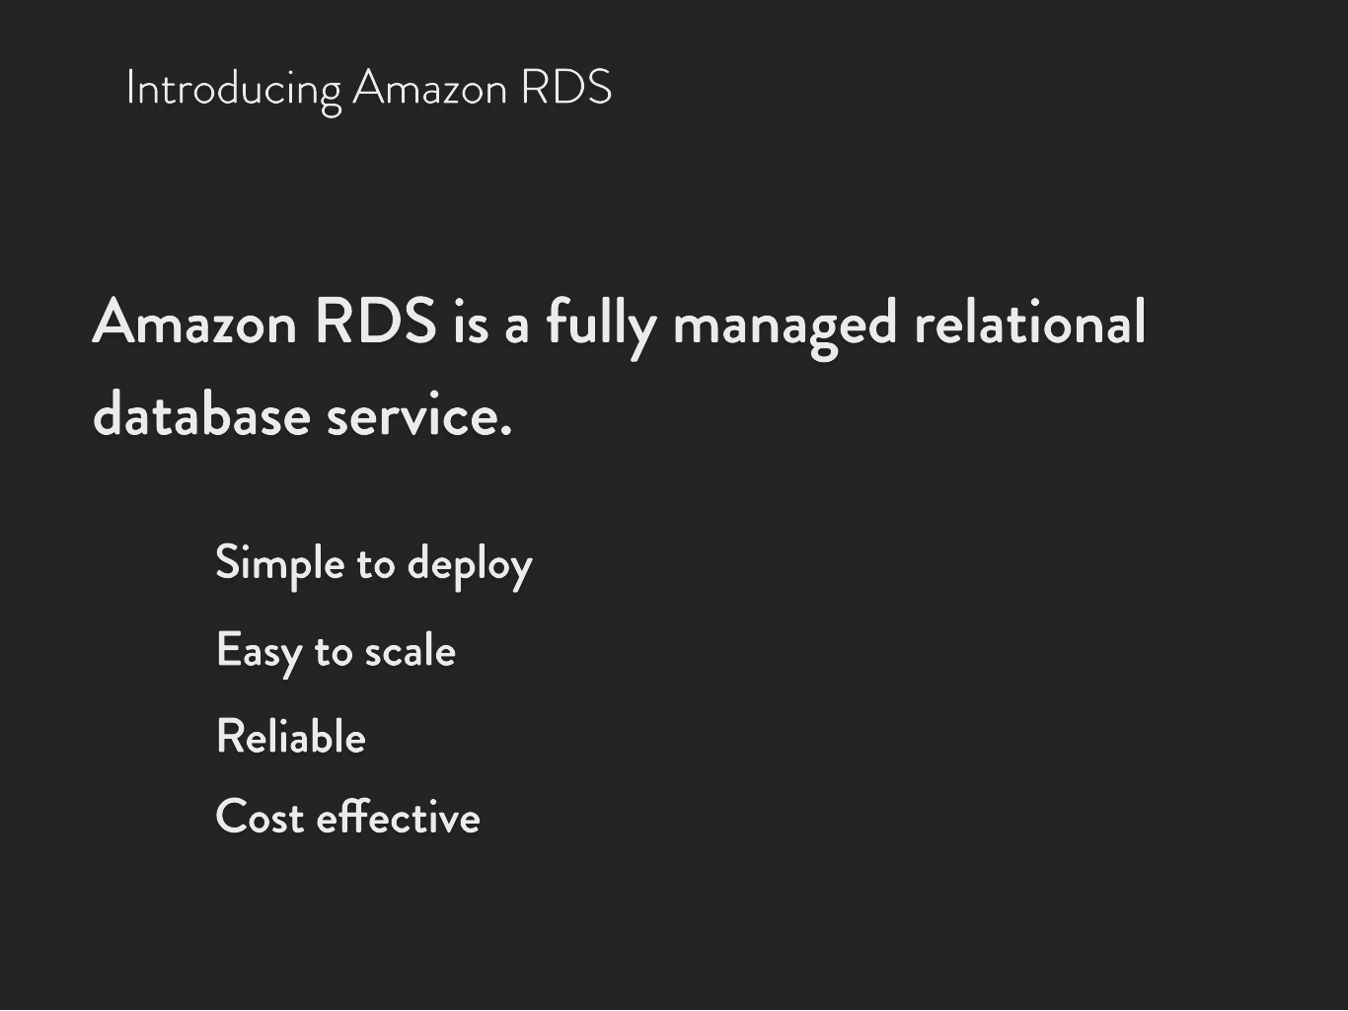

Slide 19
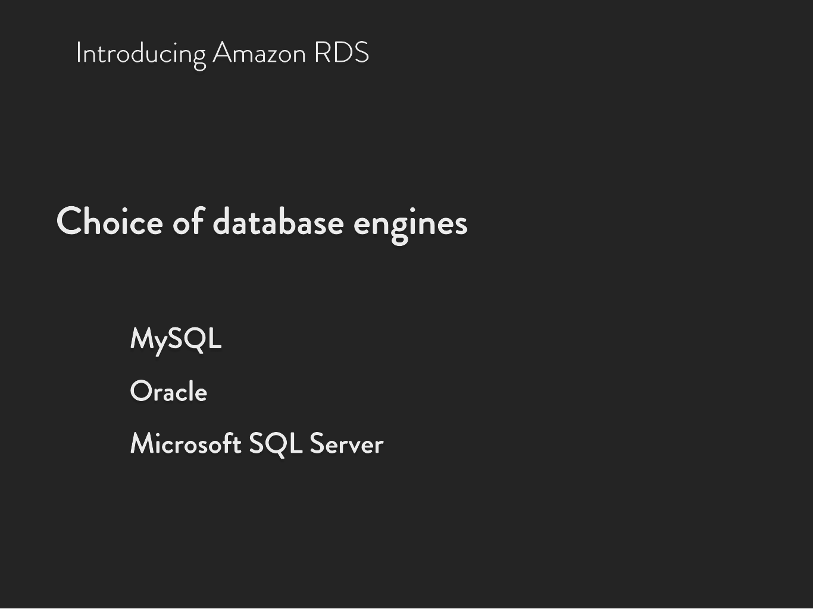
i Introducing Amazon RDS

Slide 20
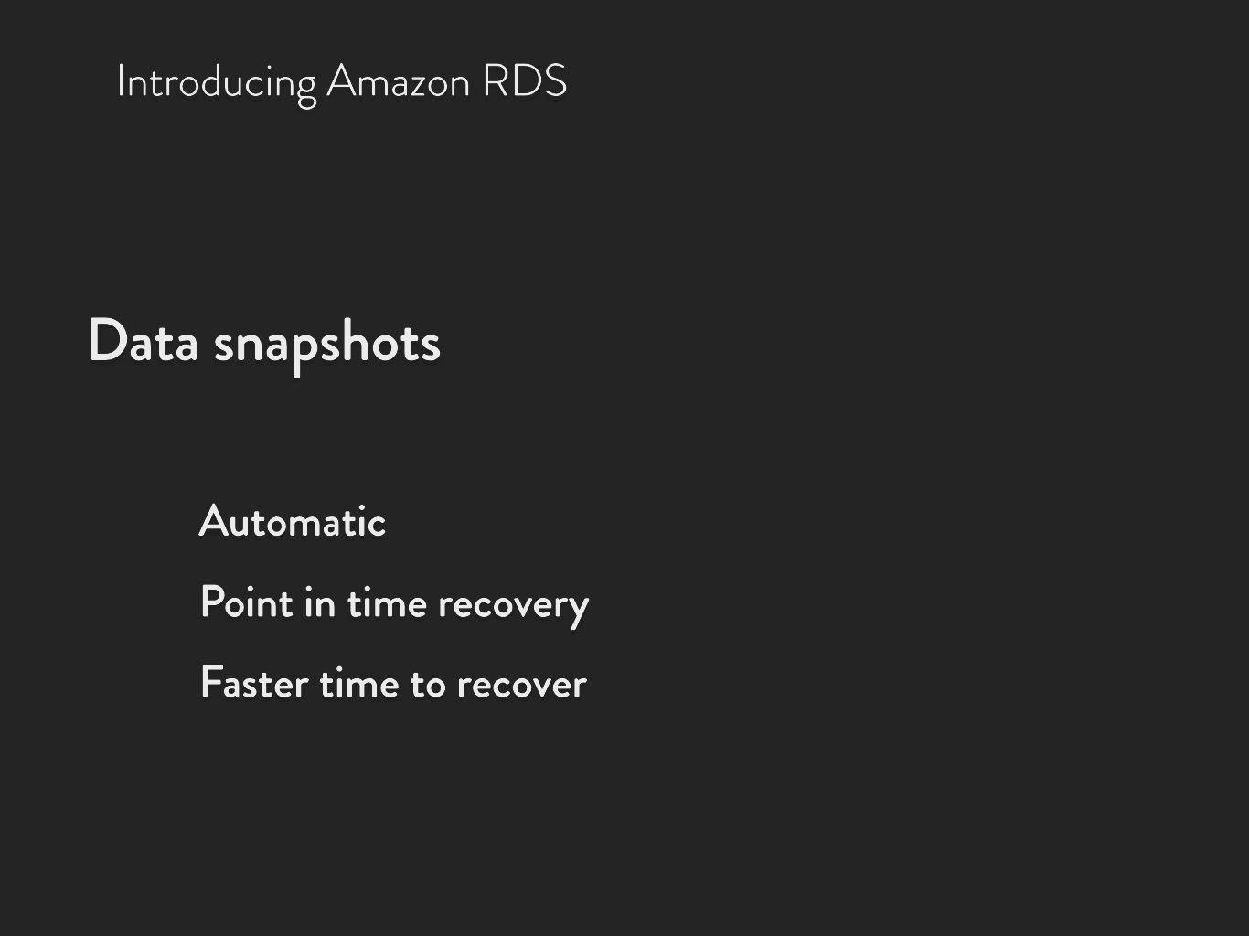
i Introducing Amazon RDS

Slide 21
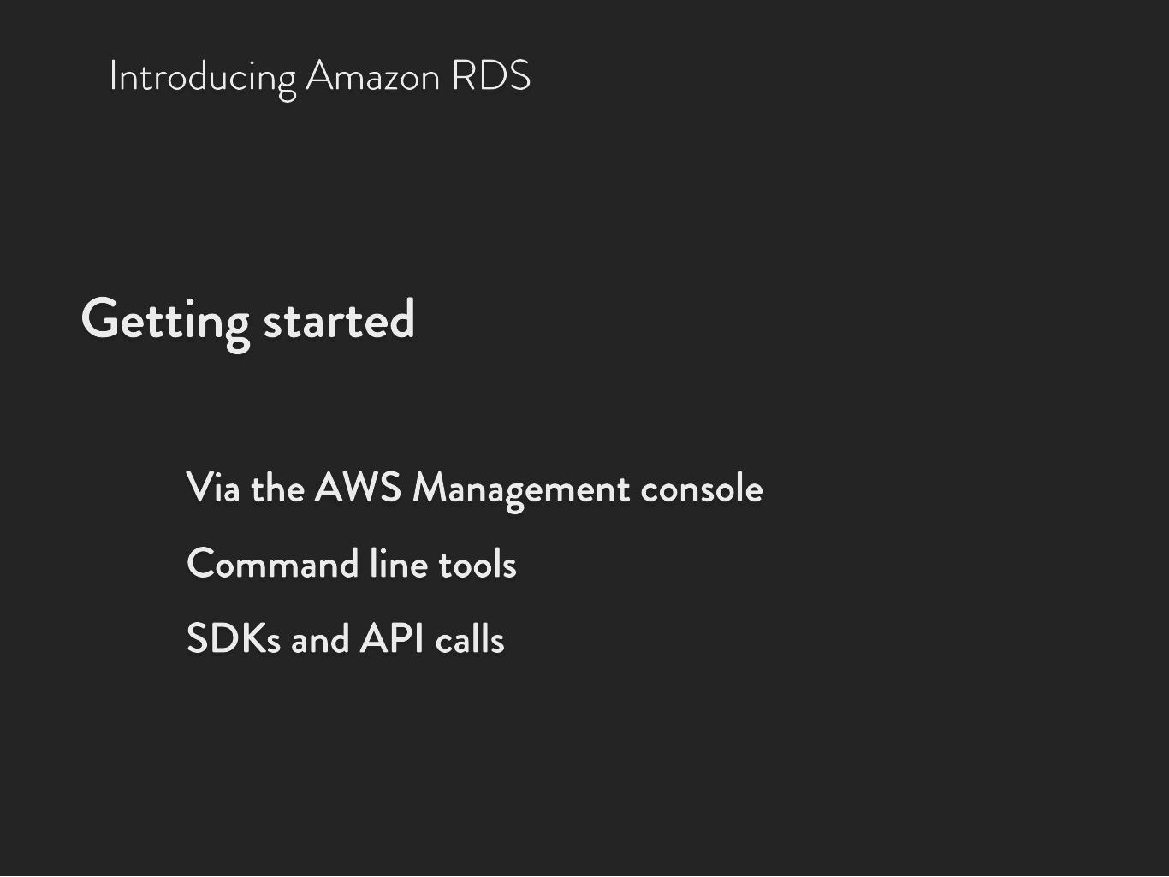
i Introducing Amazon RDS

Slide 22



Slide 23


l

Slide 24


l
T

Slide 25


l
T
8

Slide 26
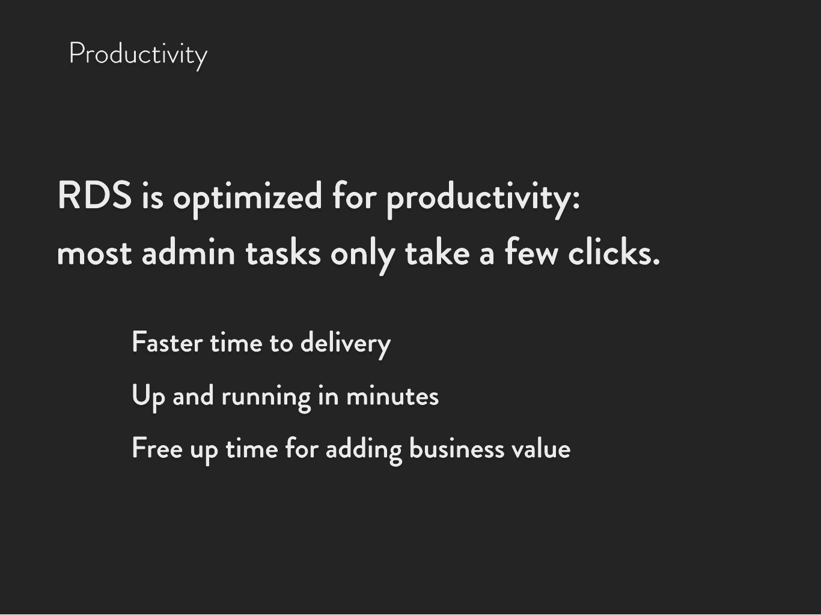


l Productivity

Slide 27
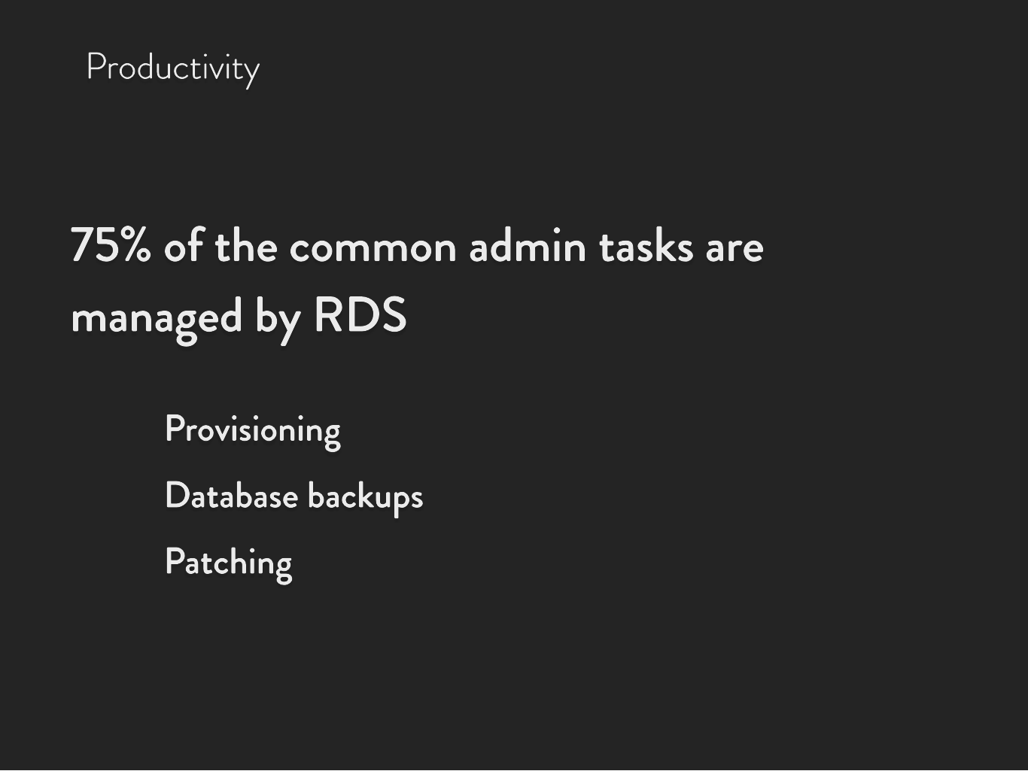


l Productivity

Slide 28




l Productivity

Slide 29















l Productivity

Slide 30

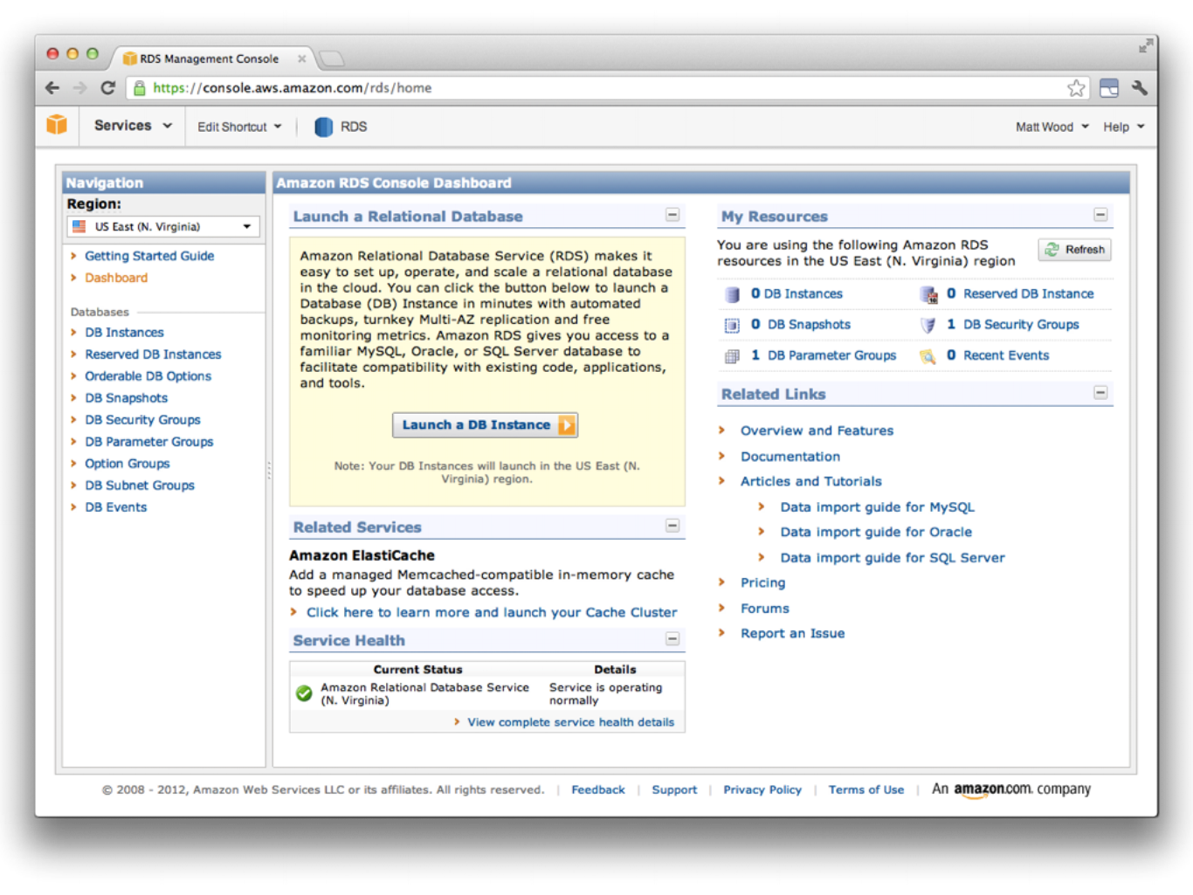

Slide 31
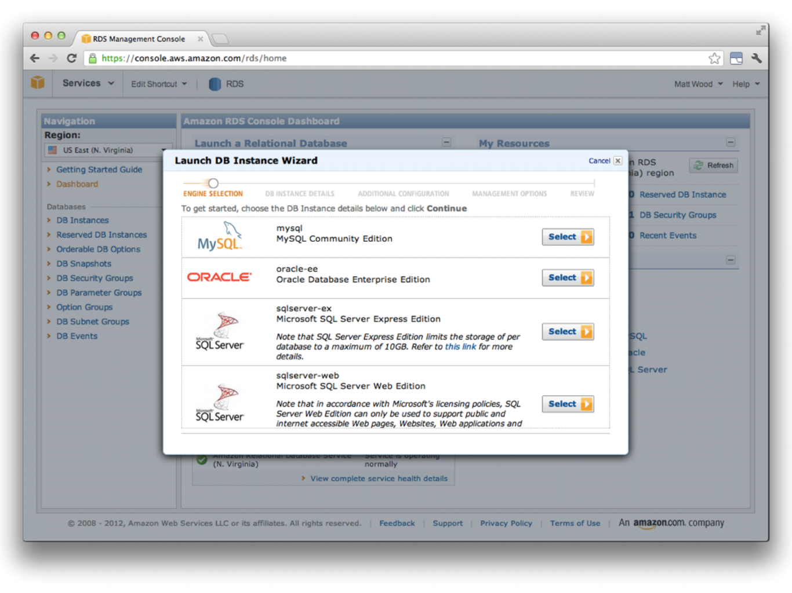

Slide 32
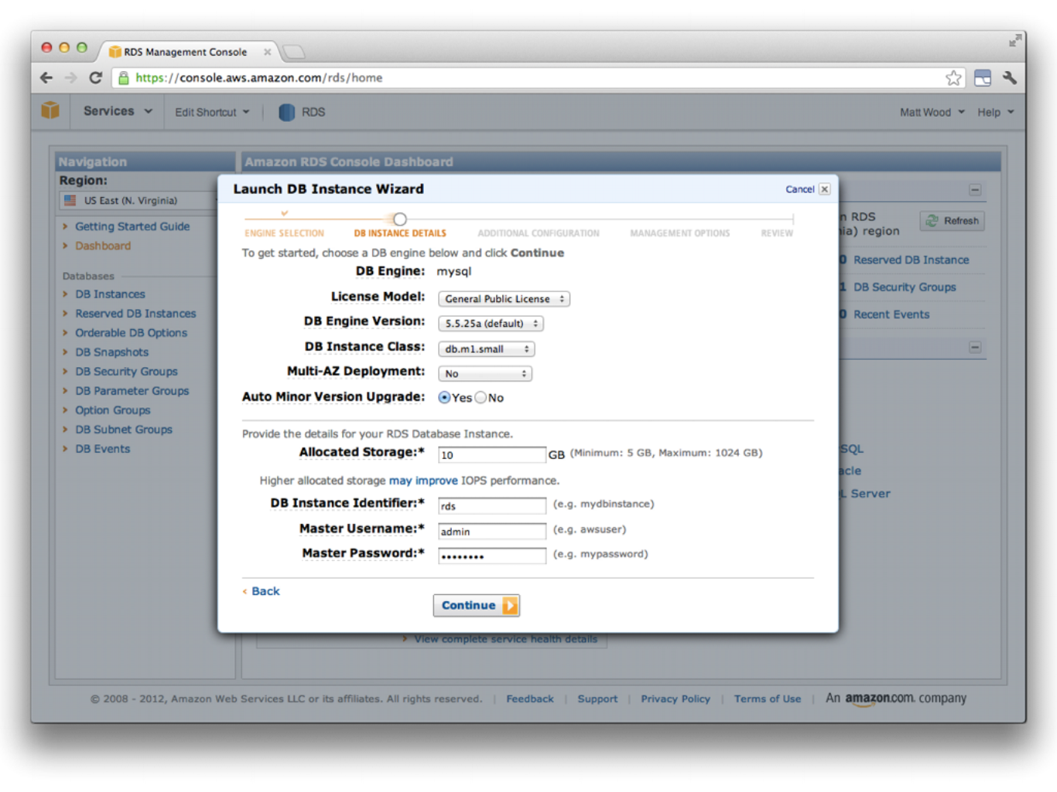

Slide 33
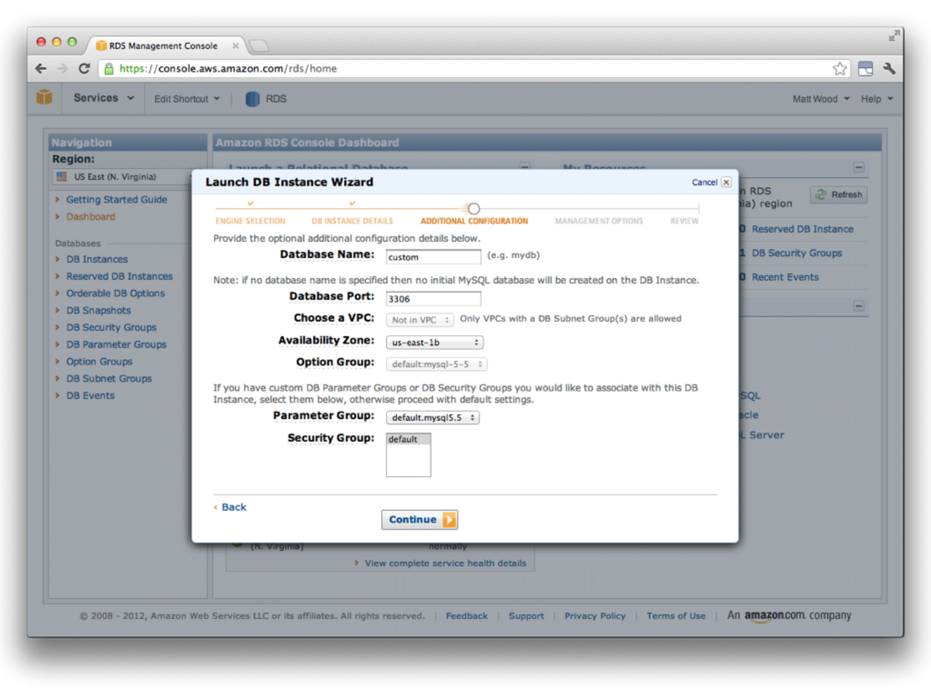

Slide 34
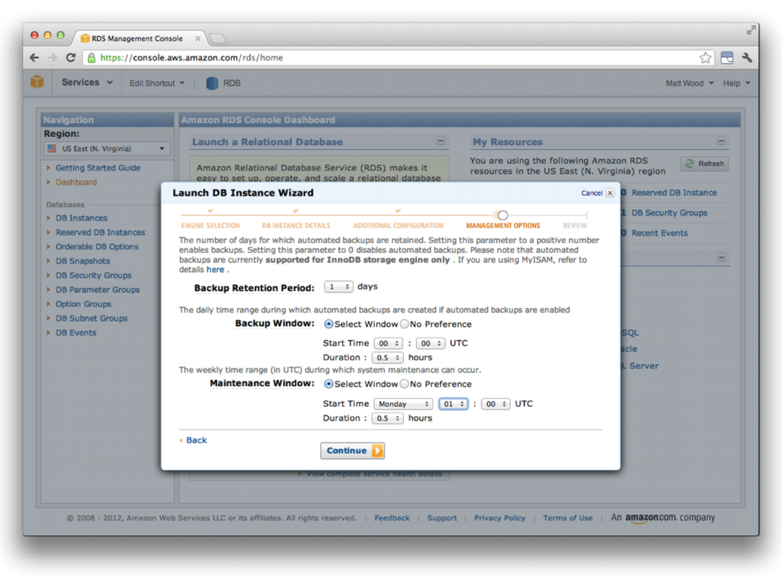

Slide 35
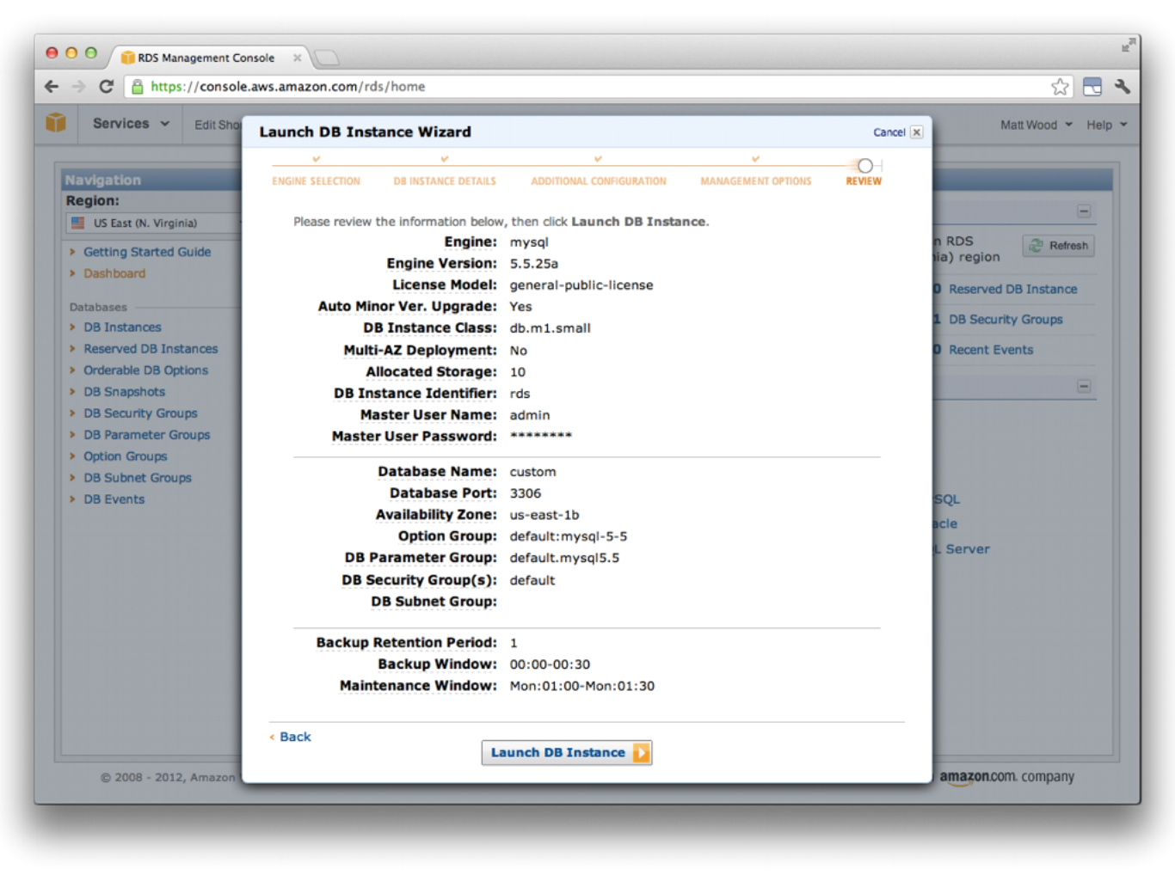

Slide 36
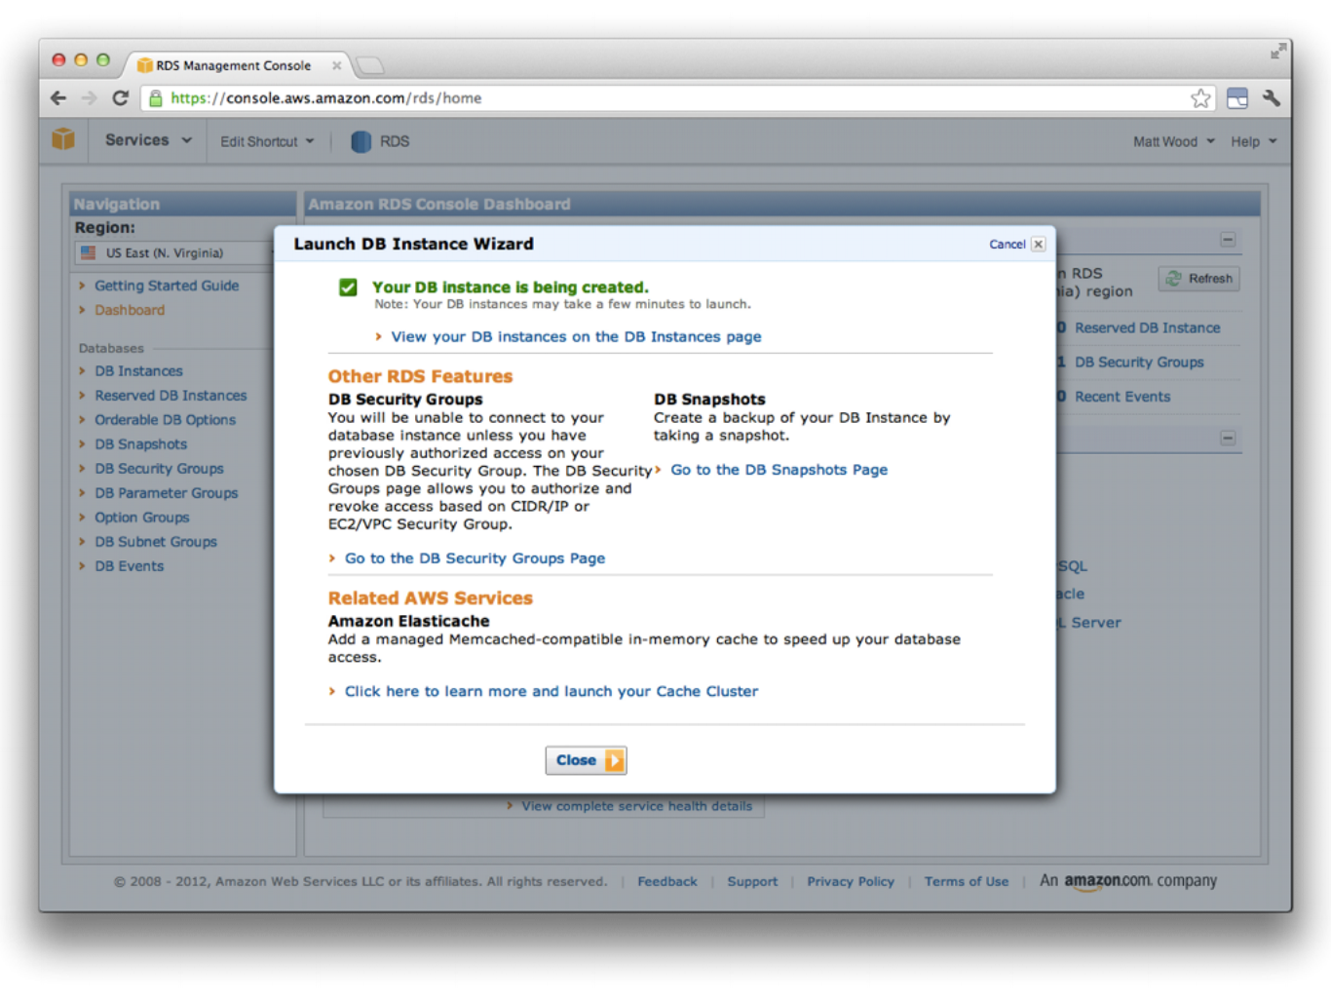

Slide 37
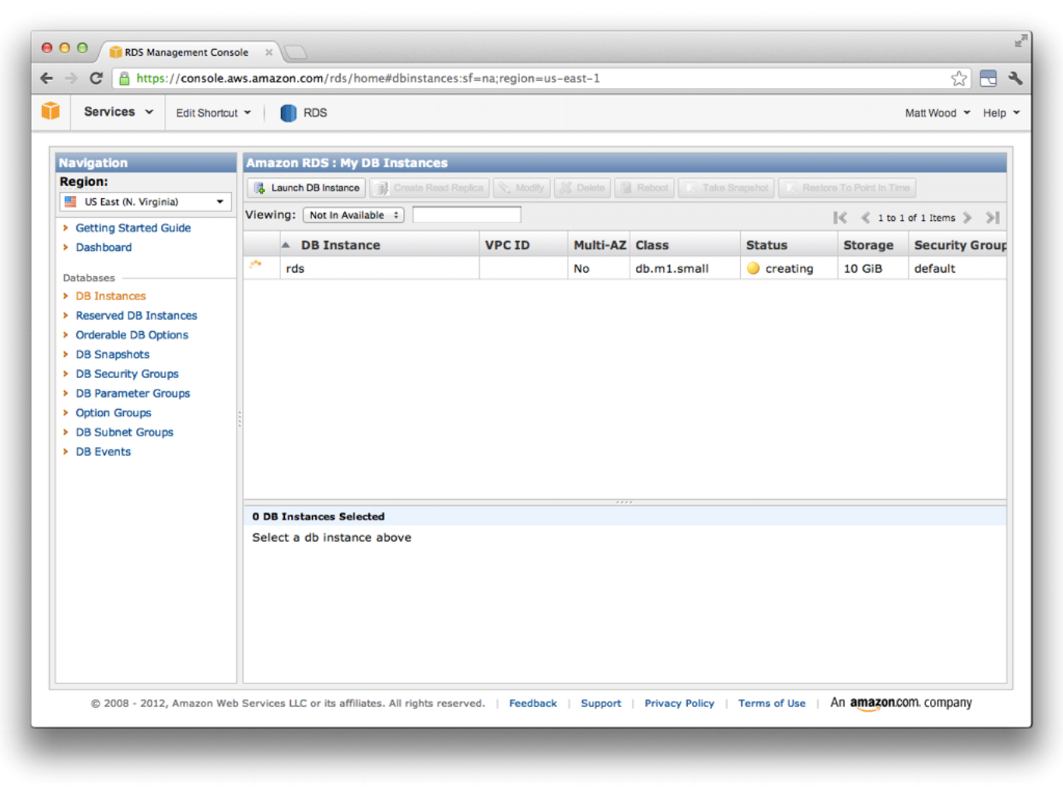

Slide 38
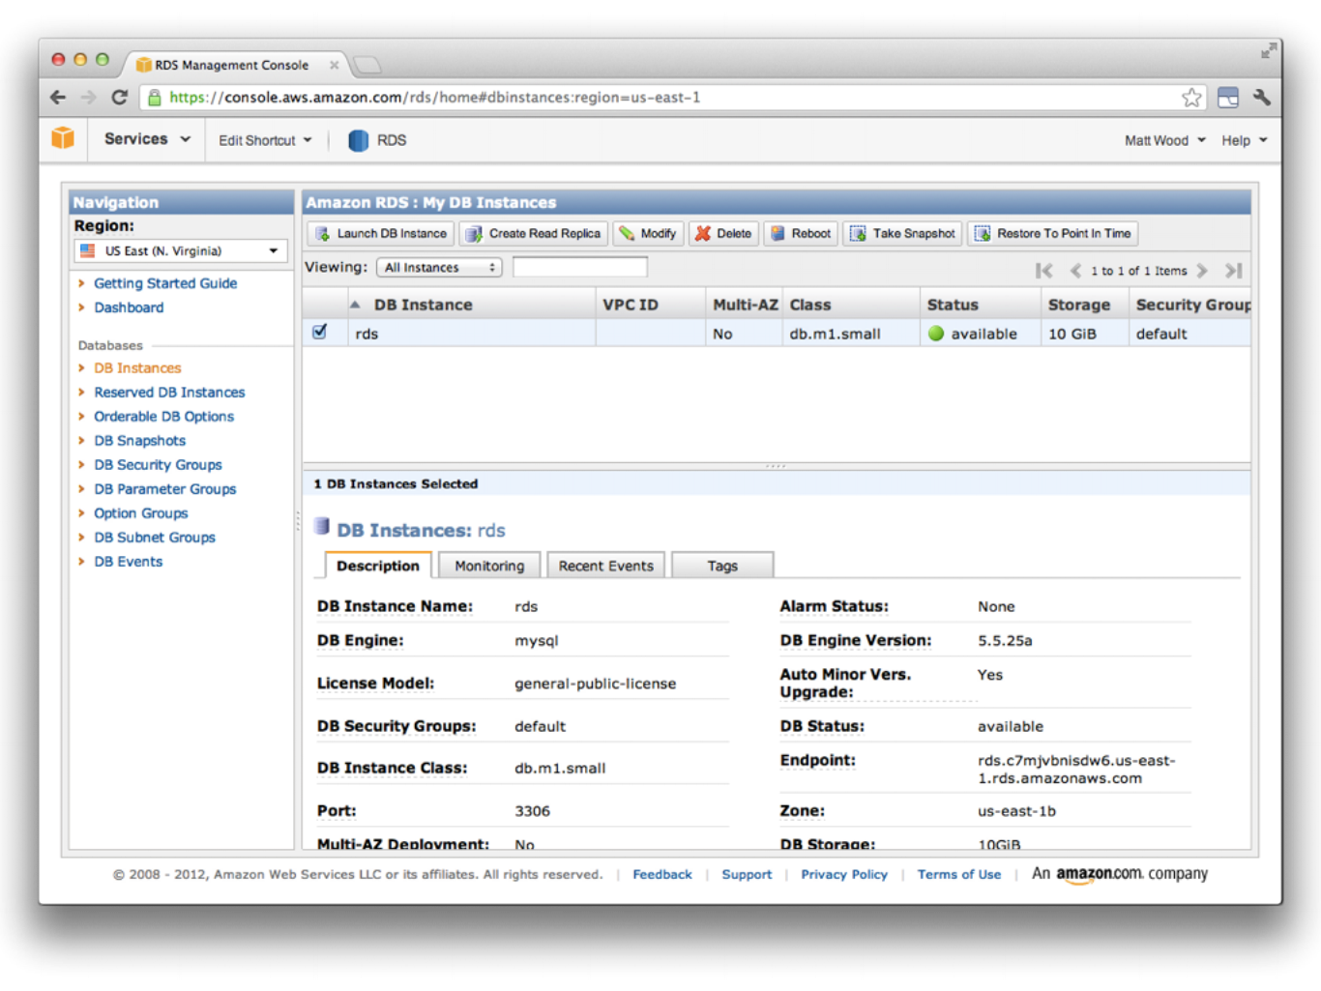

Slide 39
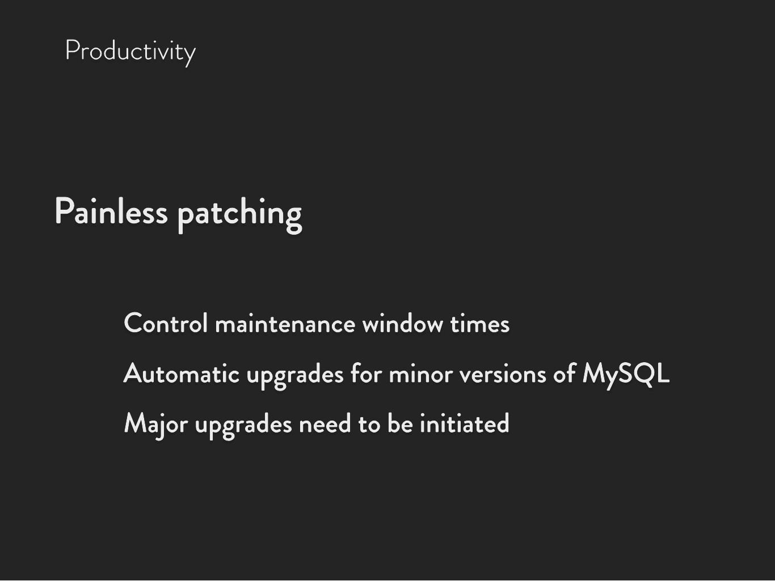
l Productivity

Slide 40




l Productivity

Slide 41




l Productivity

Slide 42






l Productivity

Slide 43
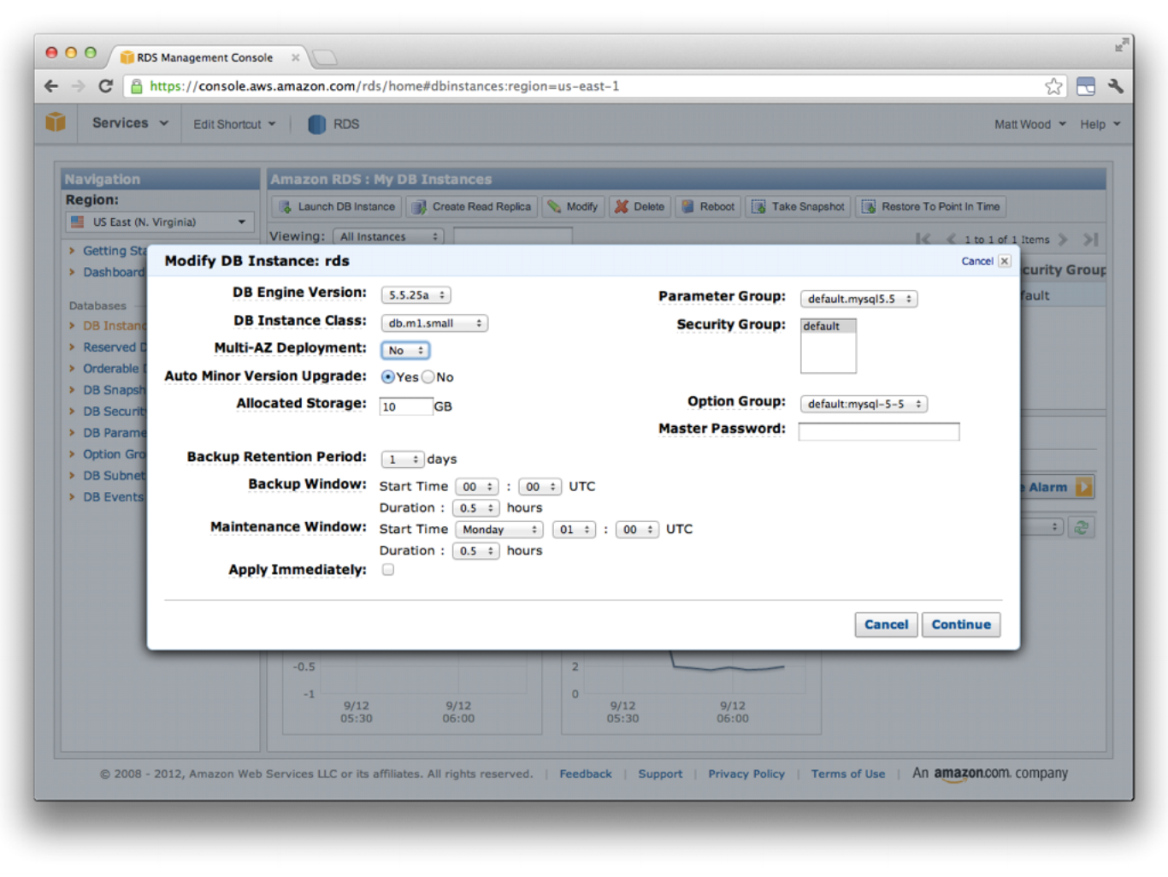

Slide 44
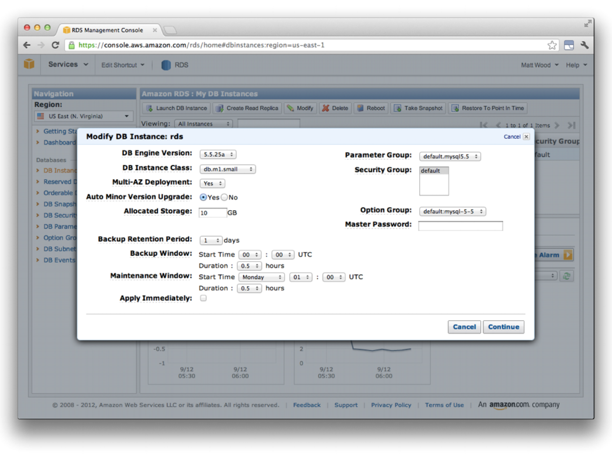

Slide 45


l Productivity

Slide 46








l Productivity

Slide 47




l Productivity

Slide 48










l Productivity

Slide 49










l Productivity

Slide 50
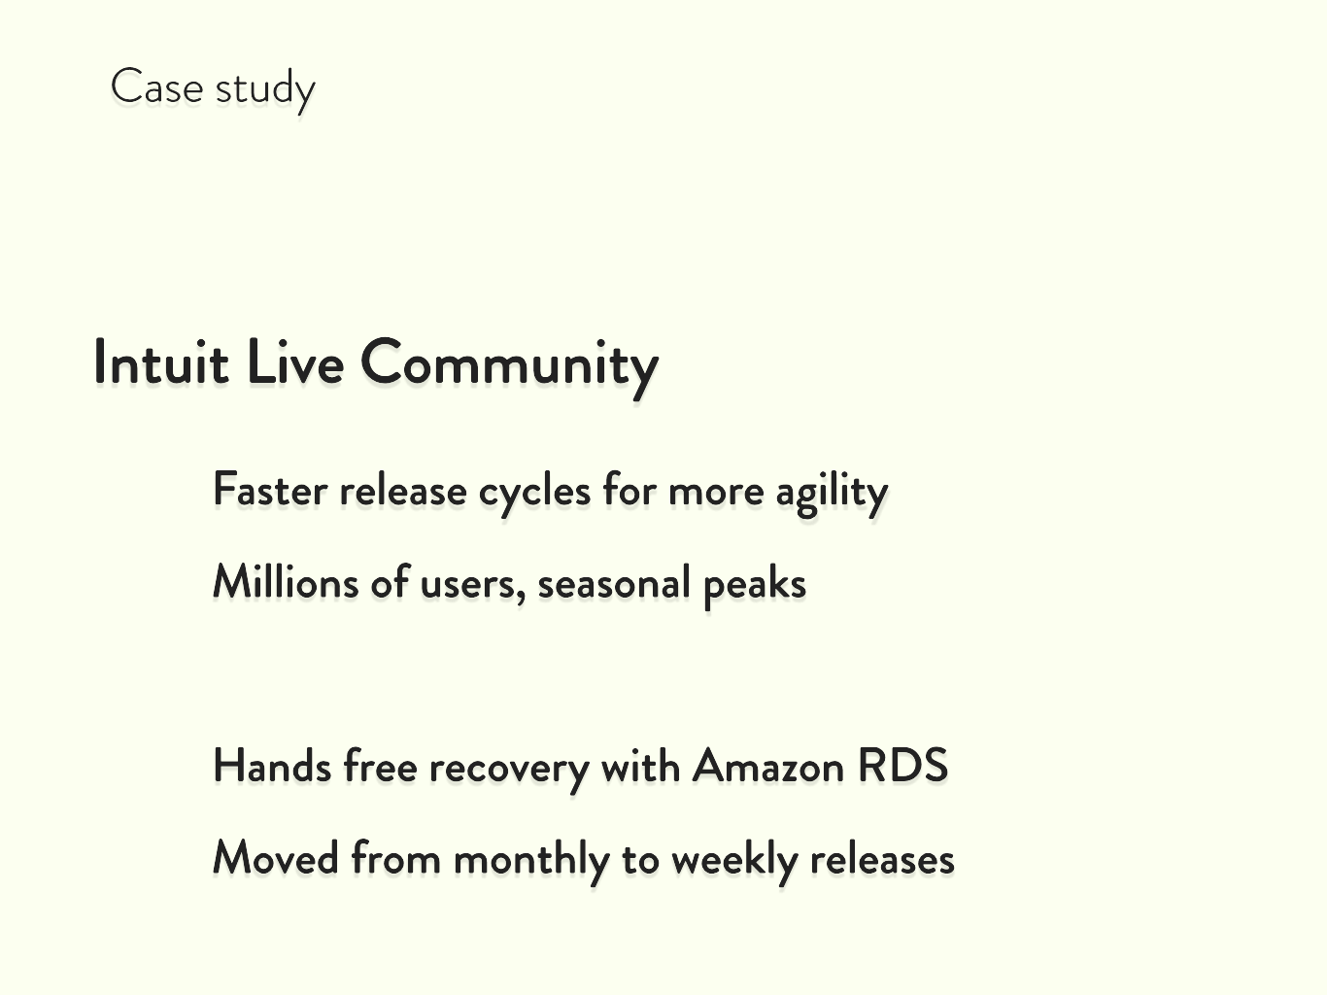
M

Slide 51
l

Slide 52
l
T

Slide 53
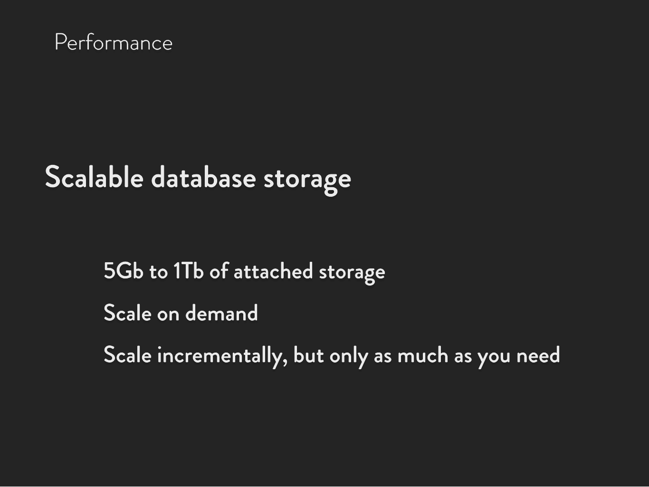
T Performance

Slide 54
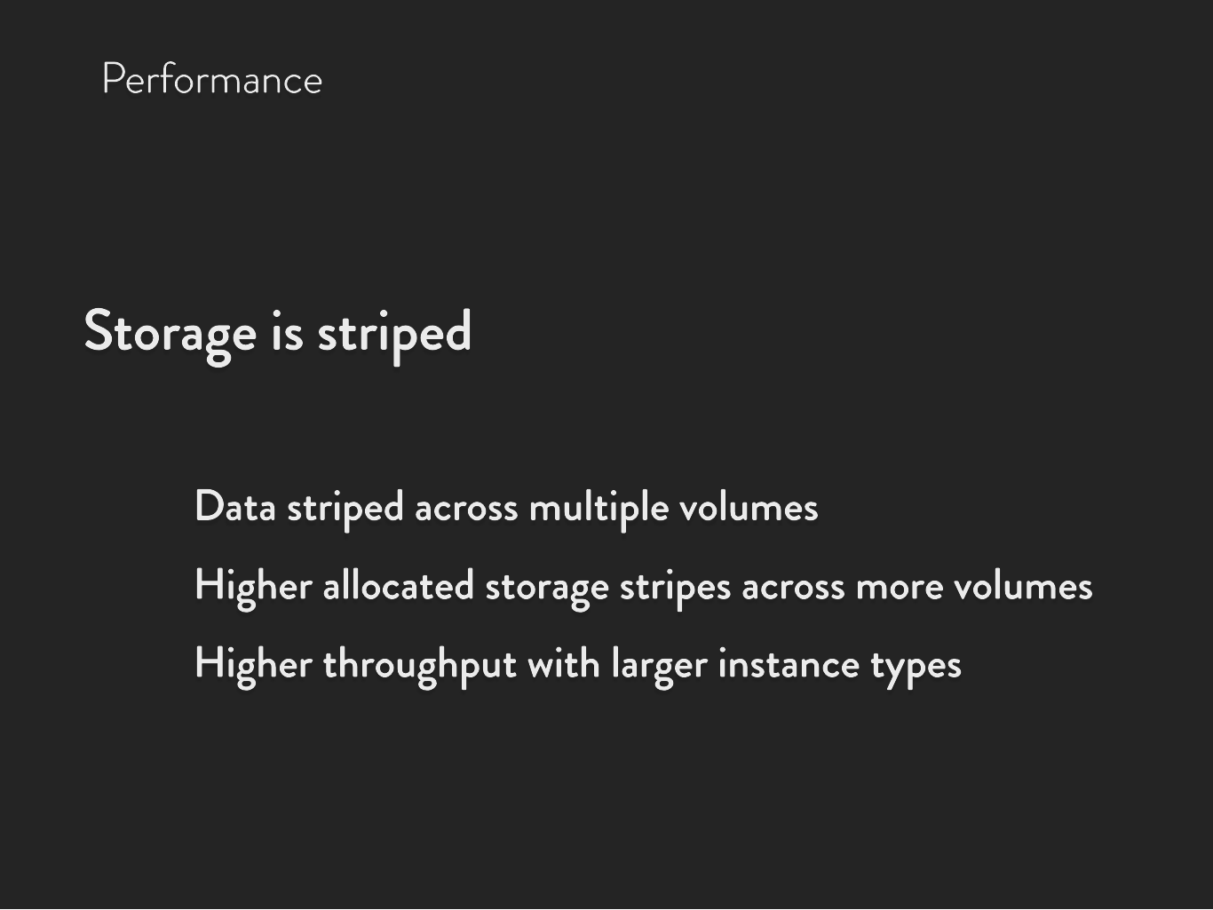
T Performance

Slide 55
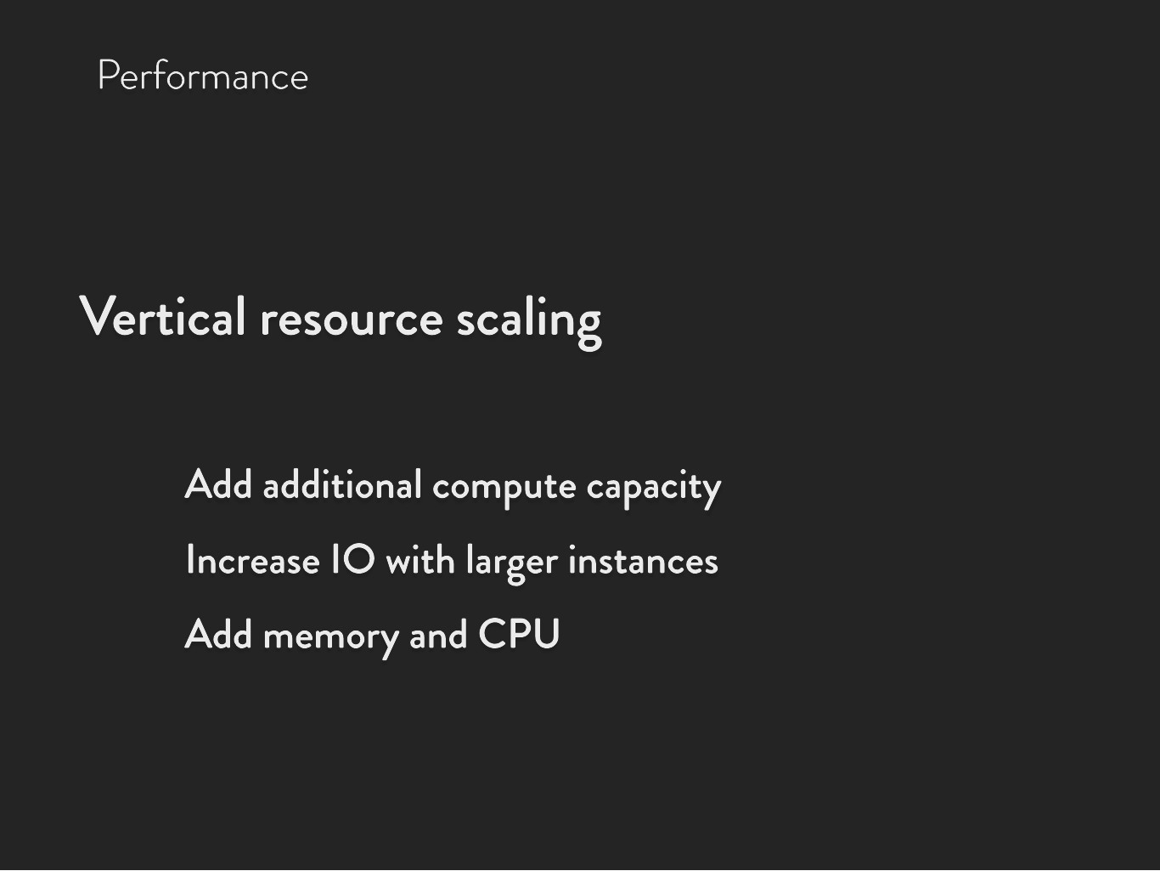
T Performance

Slide 56
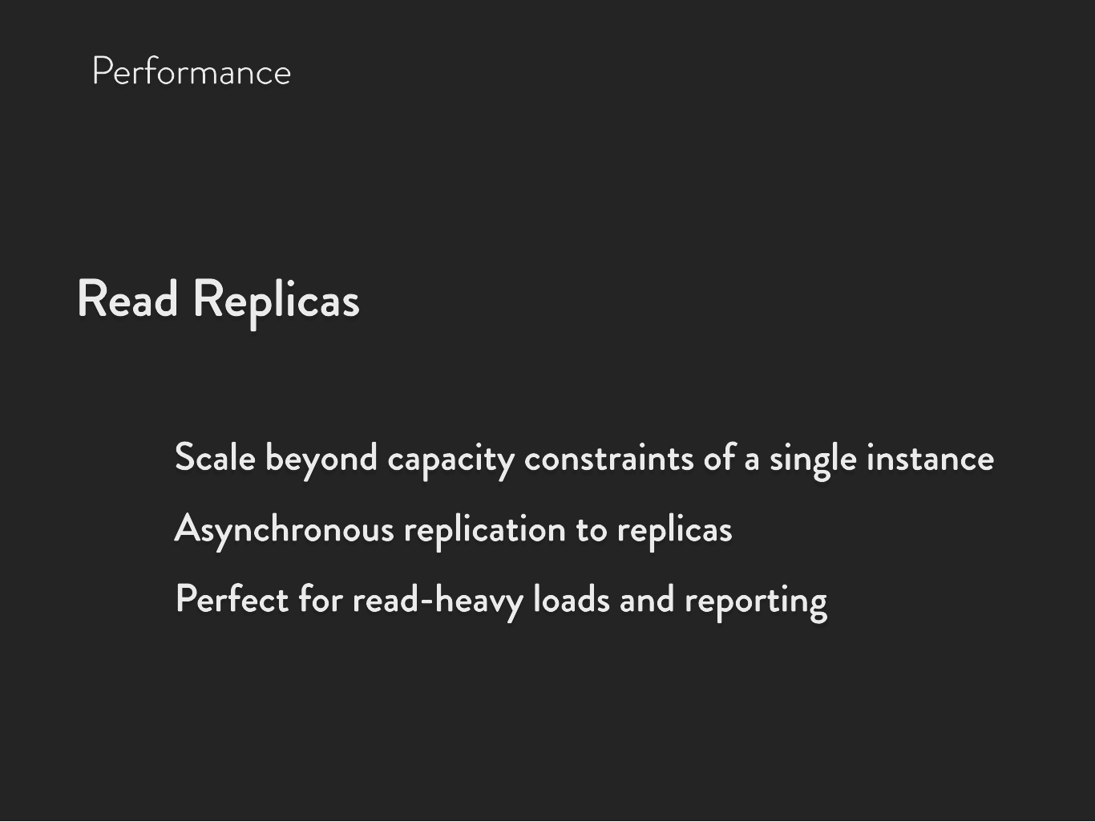
T Performance

Slide 57
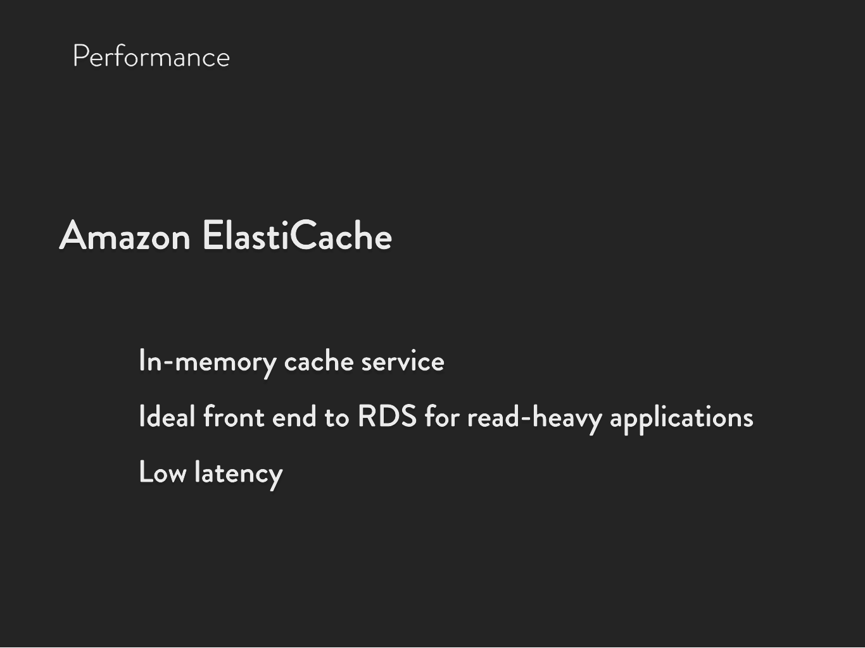
T Performance

Slide 58








T Performance

Slide 59
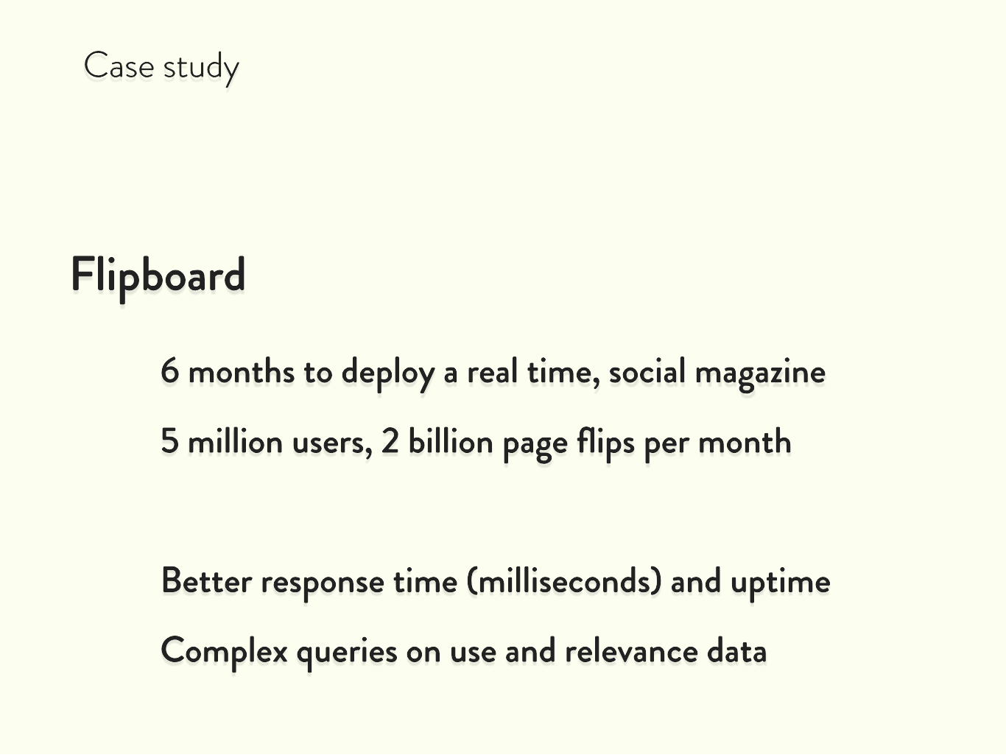
M

Slide 60
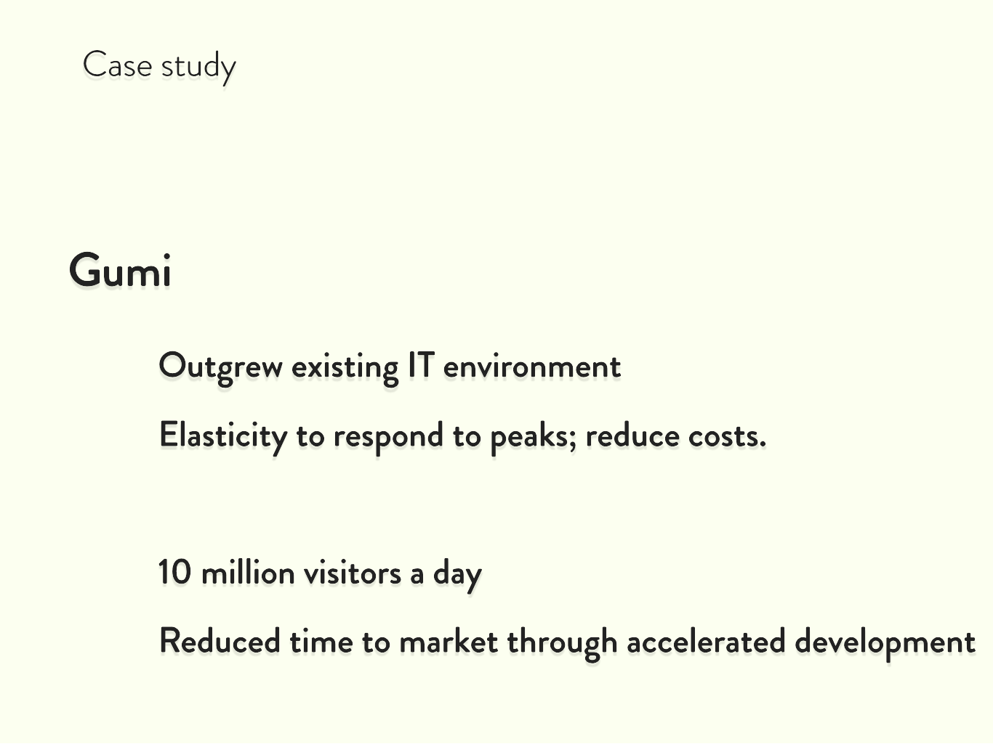


M

Slide 61
l
T

Slide 62
l
T
8

Slide 63
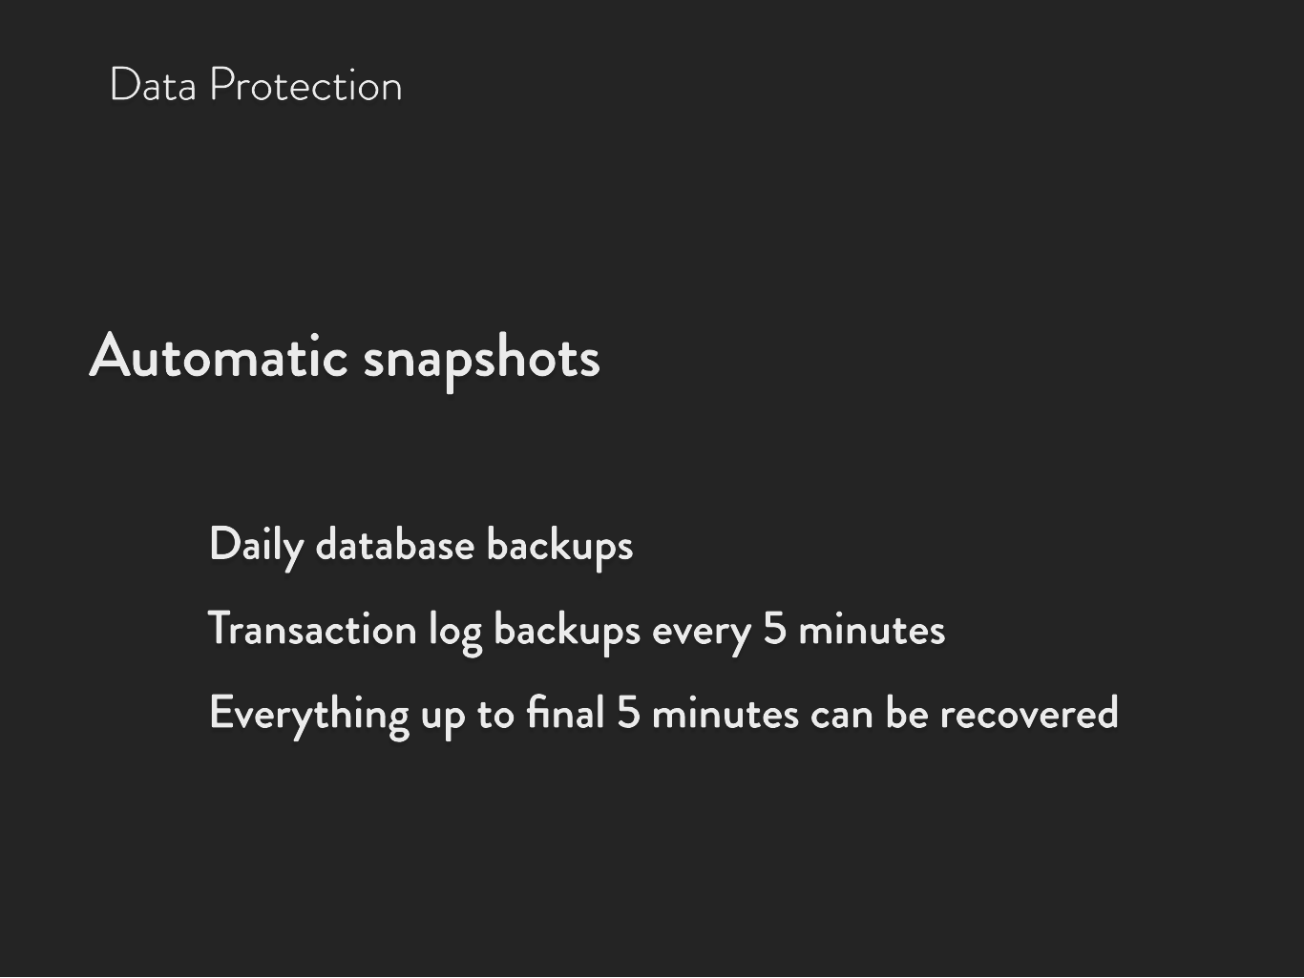
8 Data Protection

Slide 64








8 Data Protection

Slide 65




8 Data Protection

Slide 66
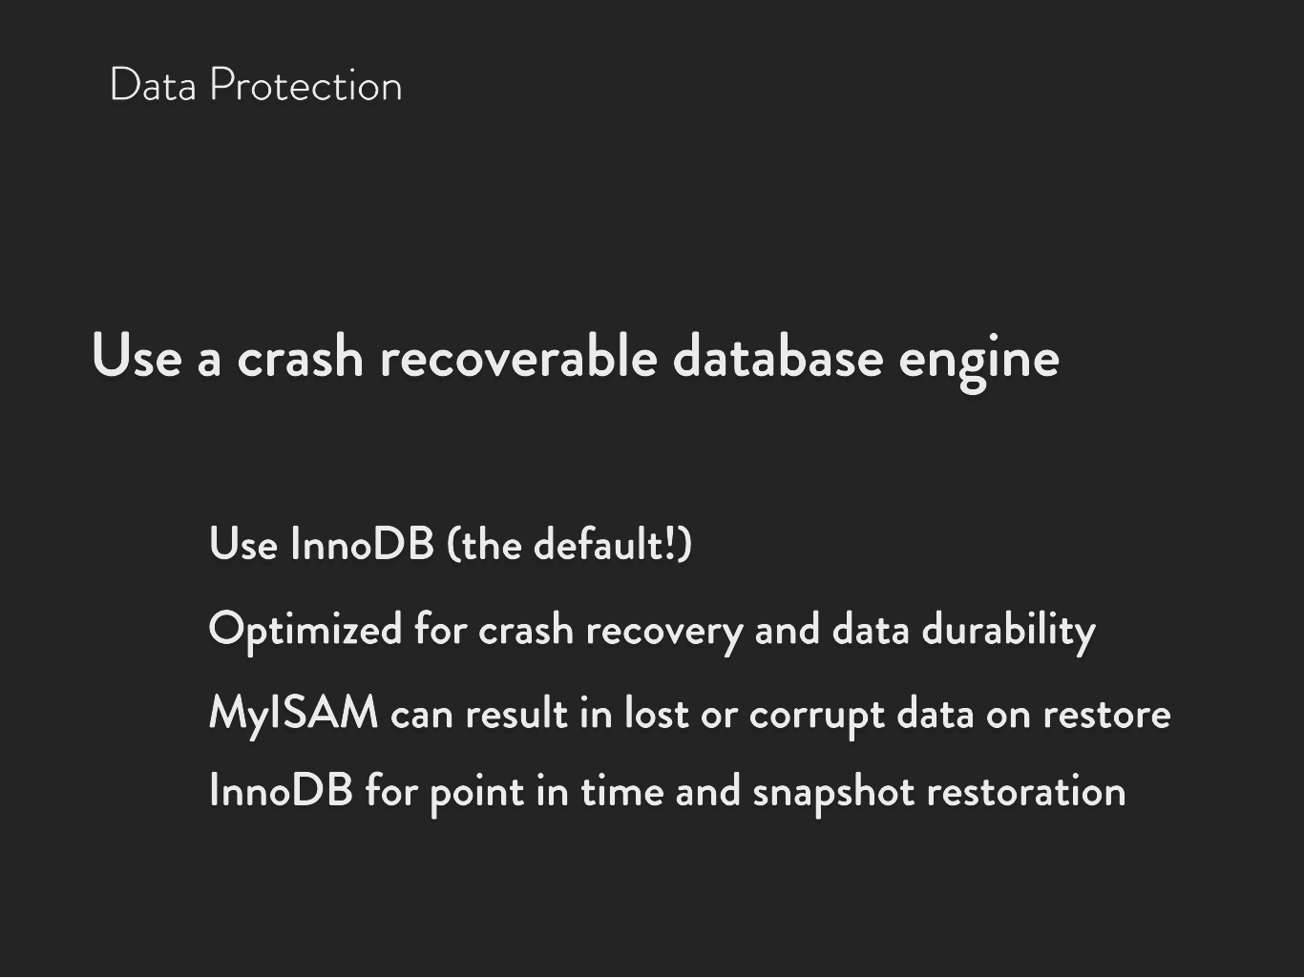
8 Data Protection

Slide 67


8 Data Protection

Slide 68


8 Data Protection

Slide 69


8 Data Protection

Slide 70
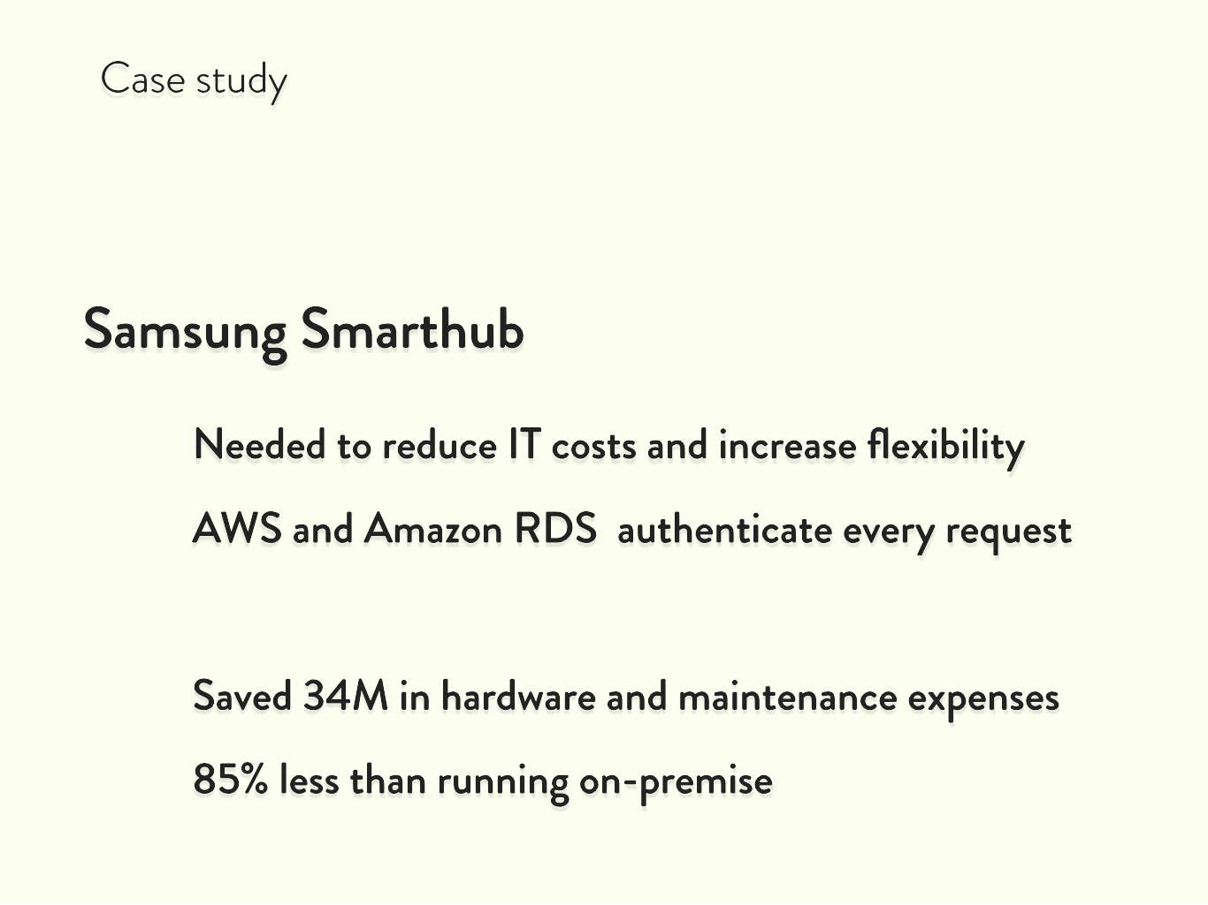
M

Slide 71
l
T
8

Slide 72






l
T
8
Bonus
s

Slide 73
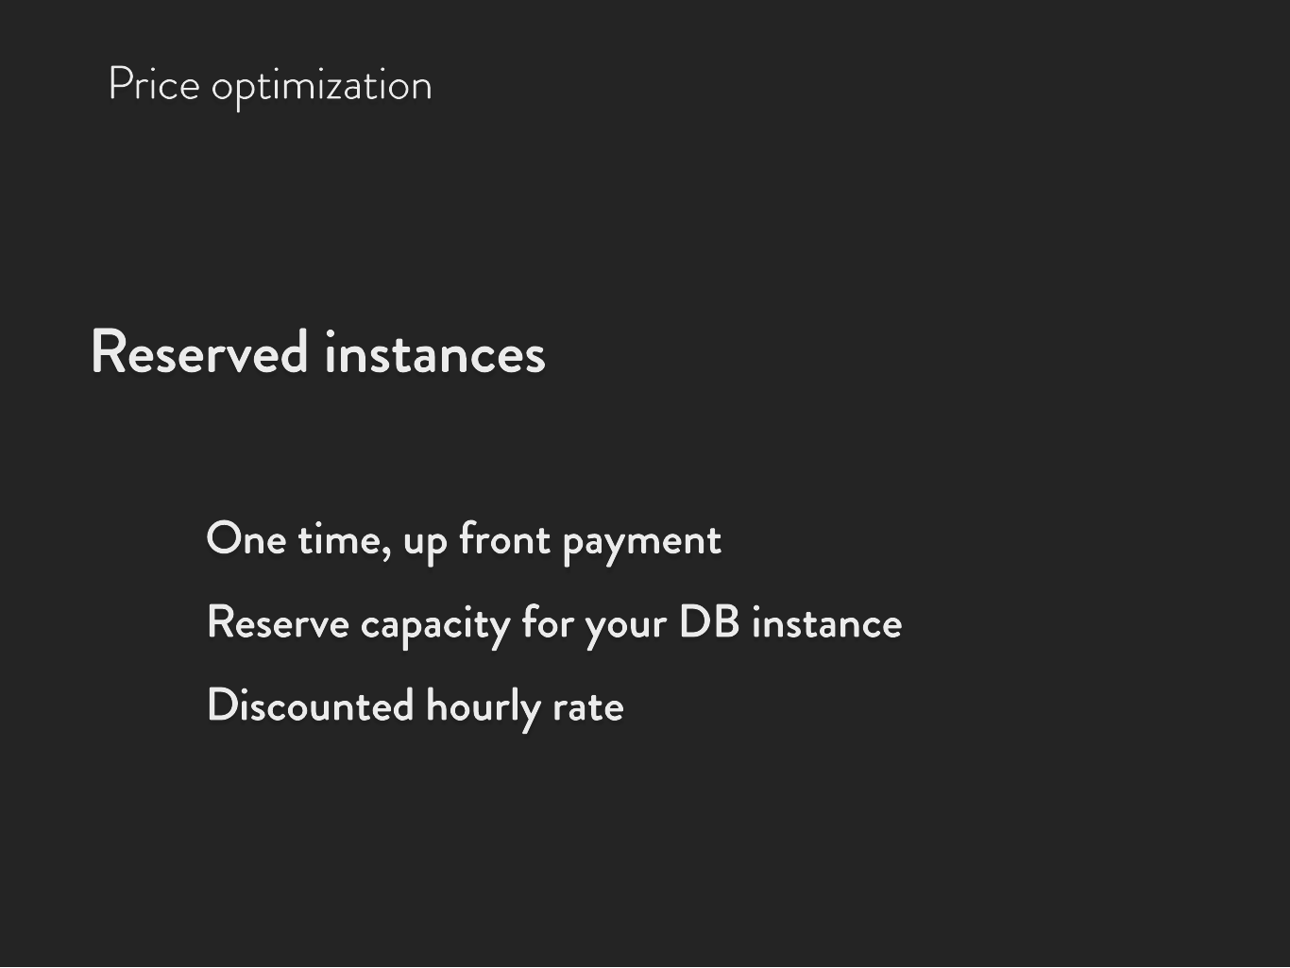
s Price optimization

Slide 75



Slide 76






Instance scaling
Multi-AZ
Performance
Backups
DR
Storage scaling

Slide 77
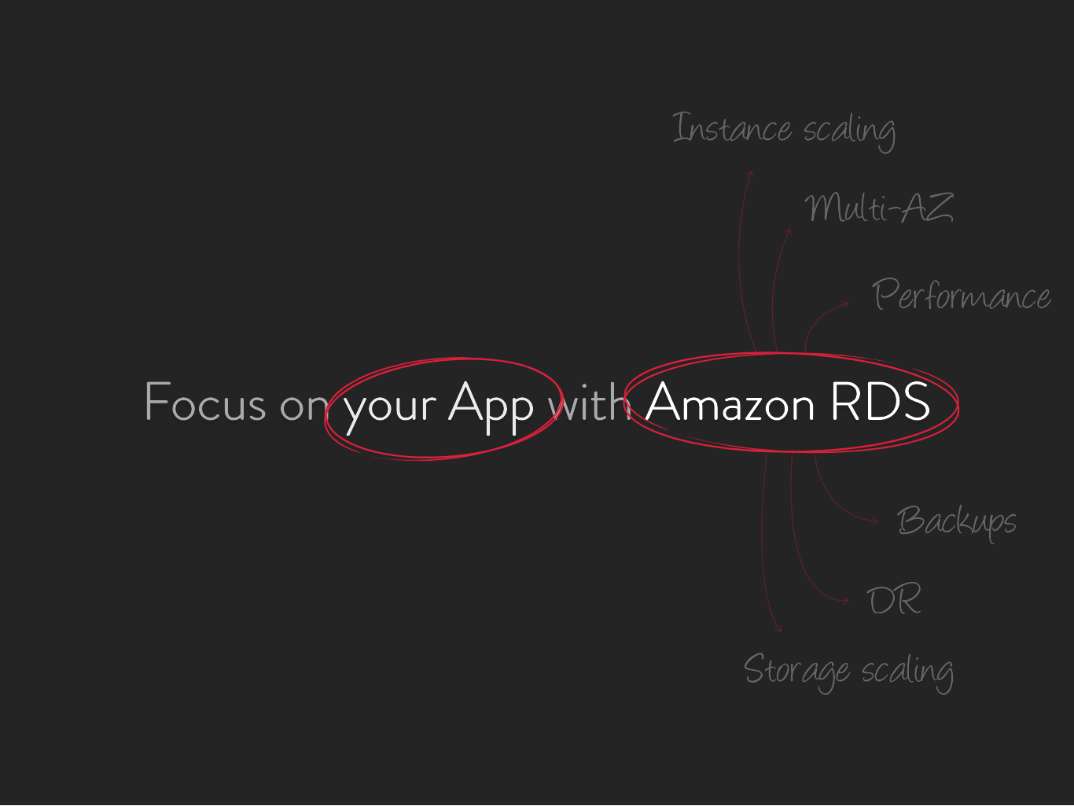

Faster updates
New features
Happy customers : )

Slide 78


h

Slide 79




f
60 day free trial

Slide 80






B

Slide 81






aws.amazon.com/rds
matthew@amazon.com

